Slide 1


Jefferson Lab Status
Hugh Montgomery
November 17, 2016

Slide 2
Outline
News
CEBAF Upgrade status
Physics highlights
12 GeV Research Program
Budgets
NSAC LRP, EIC
Outlook

Slide 3
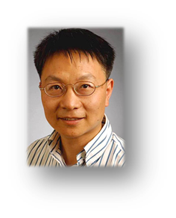
AD for Theory and Computation
Jianwei Qiu
Started at JLab October 2, 2016.
Search committee (many thanks):
Co-chairs: Joe Carlson, LANL & Bob McKeown, Jefferson Lab
Members: Charlotte Elster (Ohio U.), Franz Gross (Jefferson Lab emeritus), Frithjof Karsch (Bielefeld U. & BNL), Krishna Rajagopal (MIT), and Feng Yuan (LBNL)

Slide 4
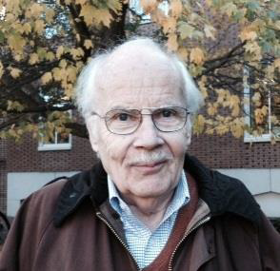
Congratulations!
2017 Tom W. Bonner Prize in Nuclear Physics Recipient
Charles F. Perdrisat
College of William and Mary
Citation:
"For groundbreaking measurements of nucleon structure, and discovering the unexpected behavior of the magnetic and electric nucleon form factors with changing momentum transfer."

Slide 5
12 GeV Upgrade Project
Total Project Cost $338M
Estimate to Complete $6M
Project Scope ~98% Complete
  Doubling Accelerator Energy – Done
  New Experimental Hall D and beamline – Done
  Civil Construction including utilities – Done
  Upgrade to Experimental Halls B & C – ~96% Complete
    Hall B & C Detectors Done
Recent DOE Review
  Schedule pressure on Solenoid delivery and commissioning
  Project was complimented for aggressive issues management
  Plan to demonstrate full project scope (except solenoid) in Spring 2017 was strongly endorsed.

Slide 6
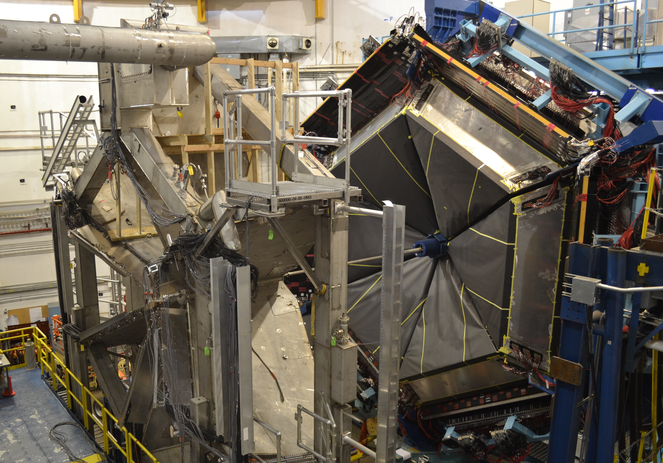
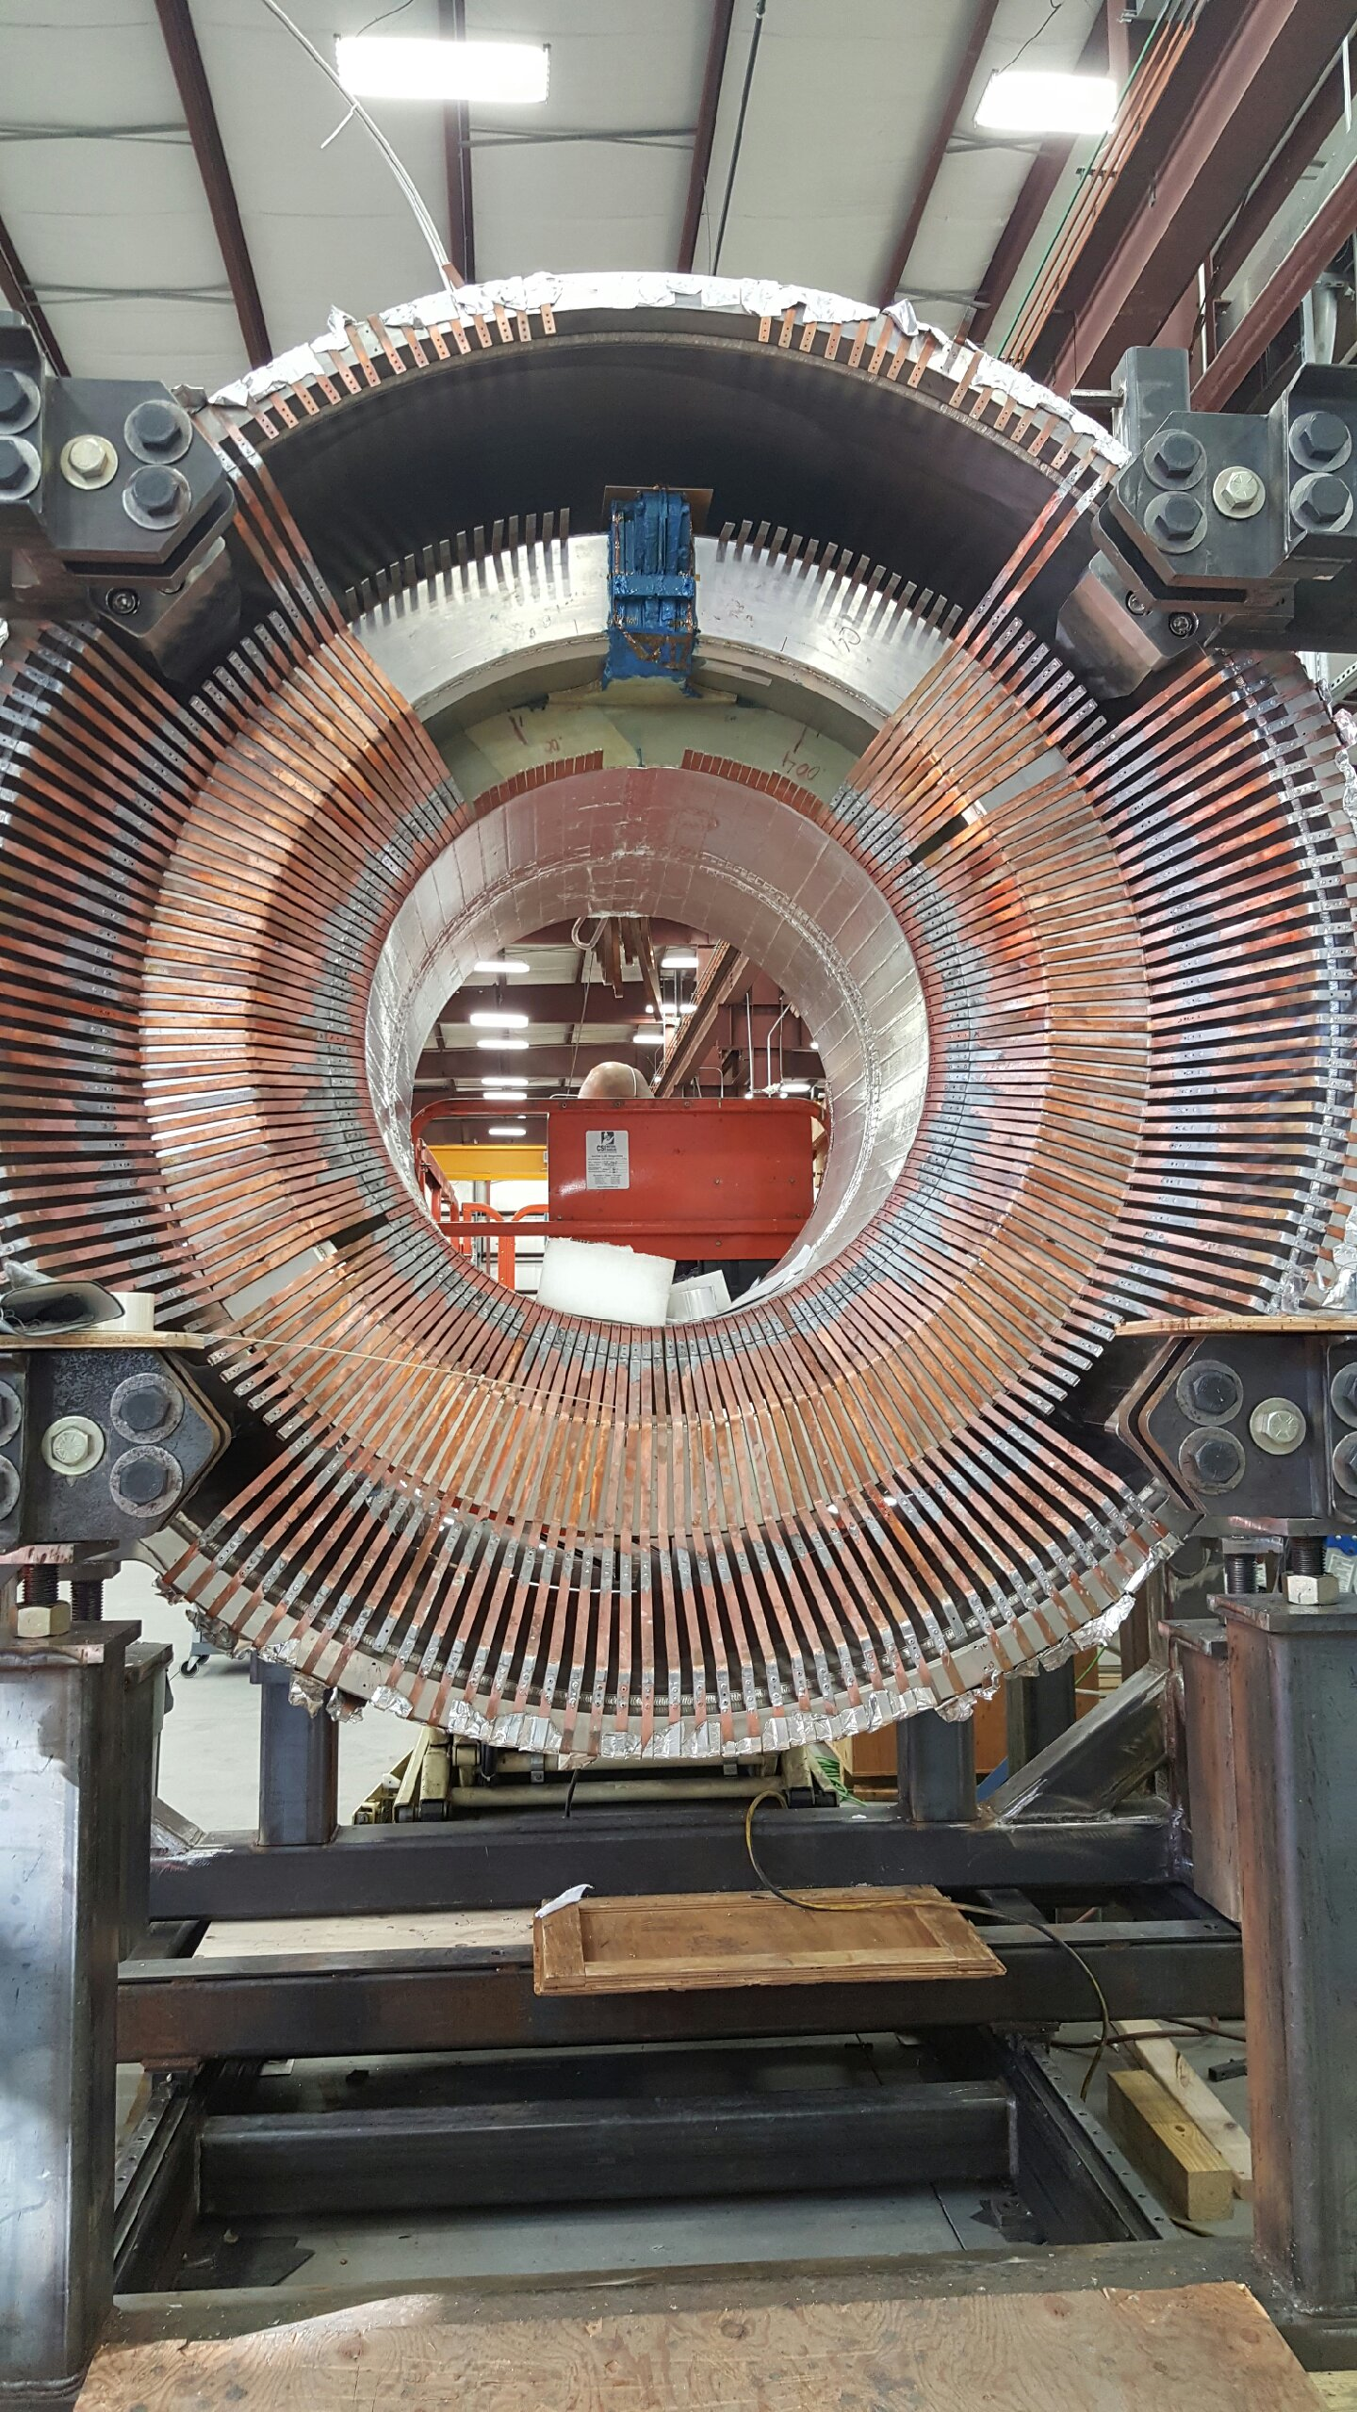
Hall B Magnets
Torus Complete & Powered to Full Current
Solenoid Coils Integrated
PCAL
Torus Magnet
FTOF
LTCC

Slide 7
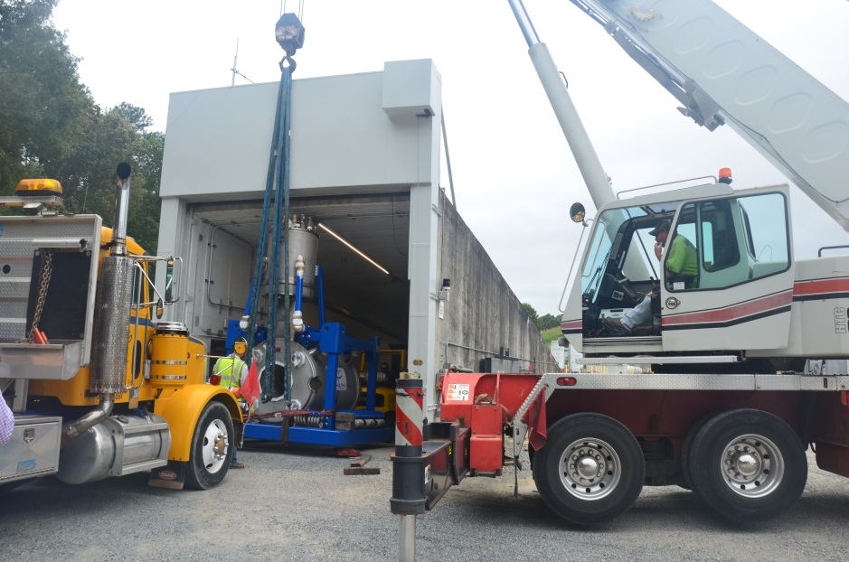
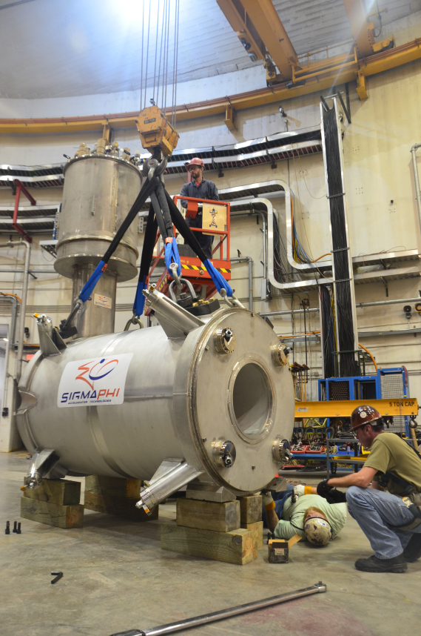
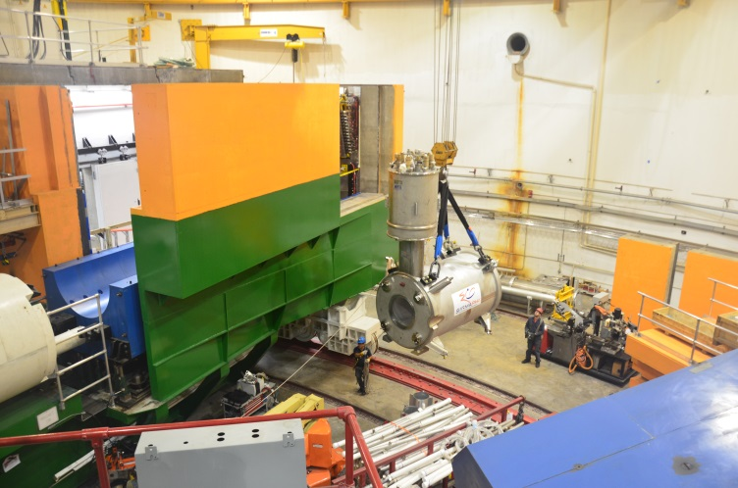
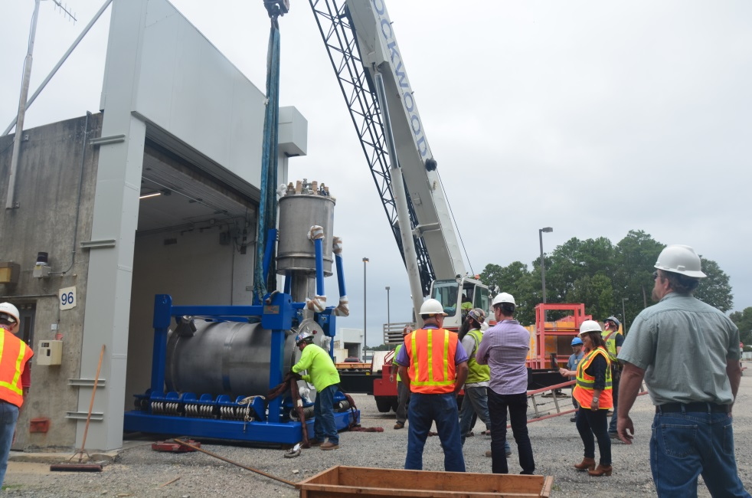
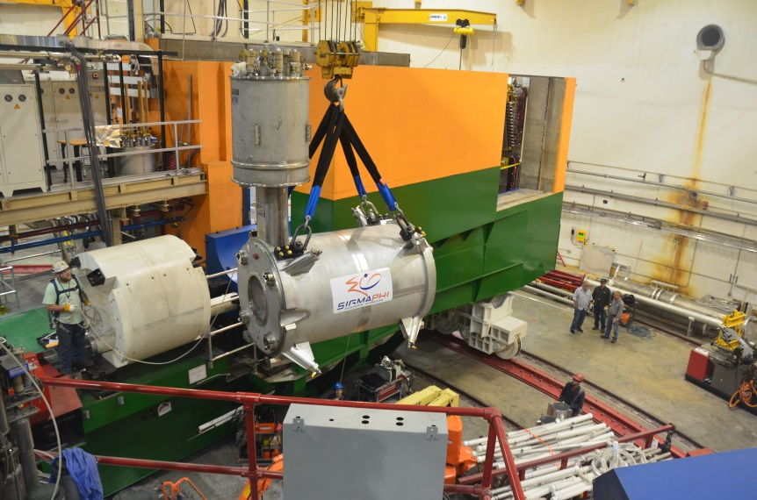
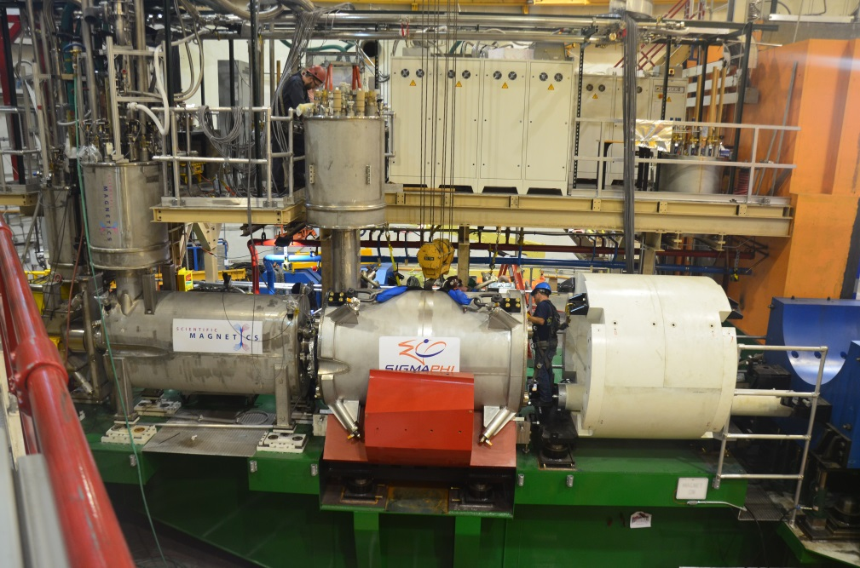
Hall C, Q2 Arrival at JLab – Oct. 6, 2016
Q2 and Dipole installed on SHMS Carriage
Q3 in Antwerp en route to Norfolk

Slide 8
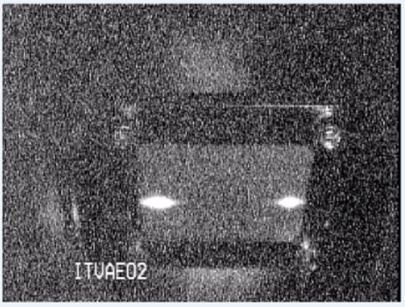
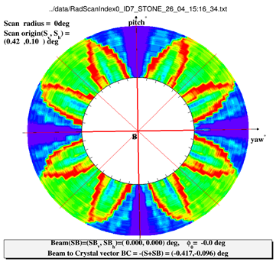
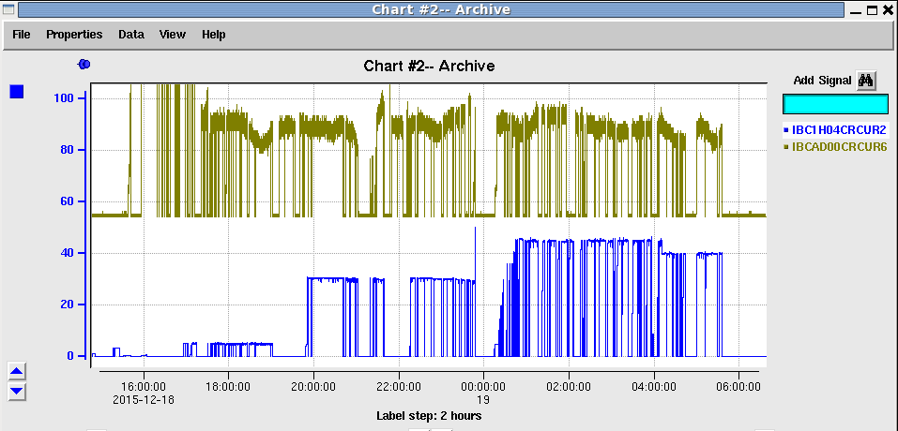
CEBAF Commissioning Highlights
A & D beam separated on 5th pass at 9.6 GeV
Spring 2015:
First simultaneous Hall A/D operations
Successful commissioning runs:
Hall B (Heavy Photon Search) and Hall D (GlueX)
Fall 2015:
First operation of CEBAF at design energy
D: 1st production polarized photons
Spring 2016:
Hall D engineering run complete
Hall A commissioning and early physics run
Hall B HPS on weekends, extended run
Summer 2016:
Proton Radius Experiment (PRad)
First completed experiment in 12 GeV era!
Accelerator ready for production physics running

Slide 9
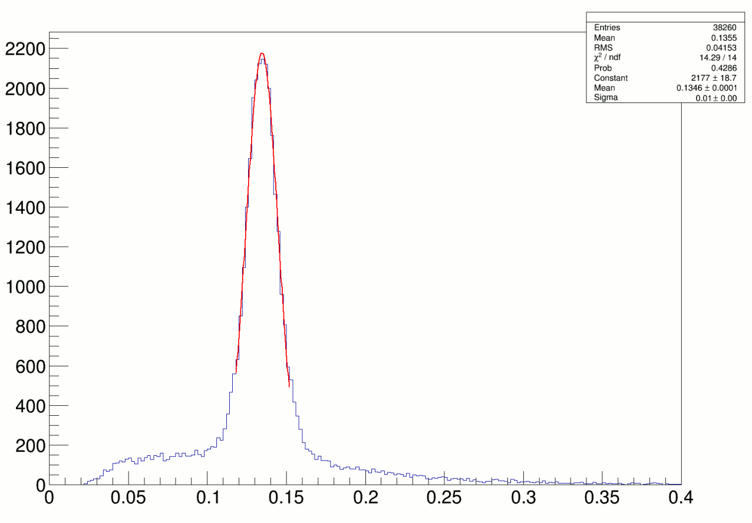
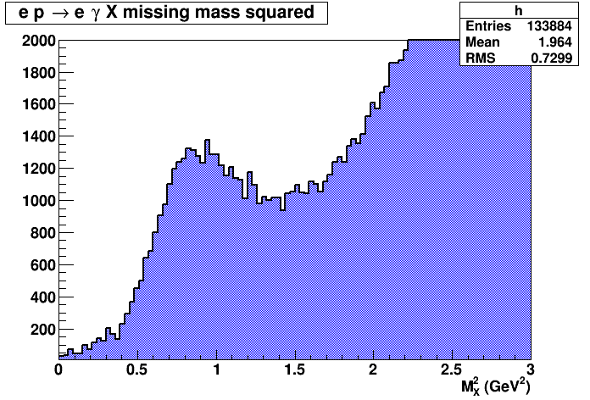
3D Imaging Program at 11 GeV
Hall A
Data reconstructed in calorimeter
Missing Mass Reconstruction
(1.5 h of beamtime)
High impact experiment for nucleon 3D imaging program
16% of experiment completed in 2014-2016

Slide 10
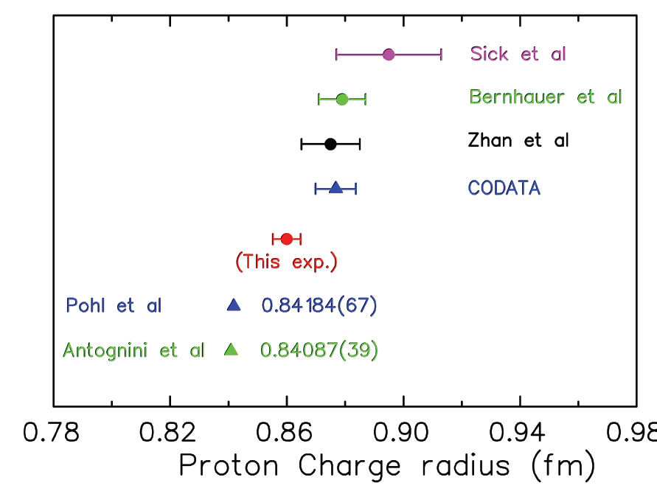

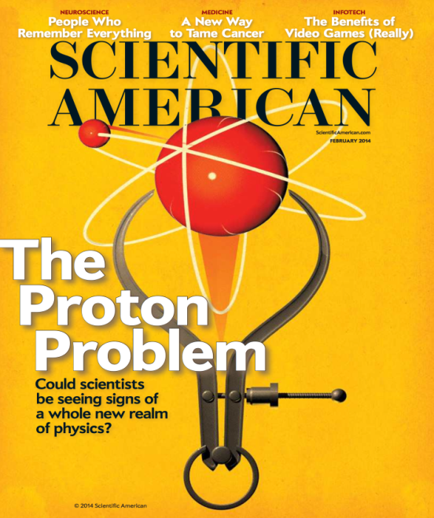
Solving the Proton Radius Puzzle
Elastic e-p
scattering
Atomic H
PRad@JLab:
(projected)
Muonic H
PRad: new experiment to
address proton radius @ JLab
NSF MRI: H₂ gas target
DOE GEM tracking detectors
Successful run in summer 2016!

Slide 11

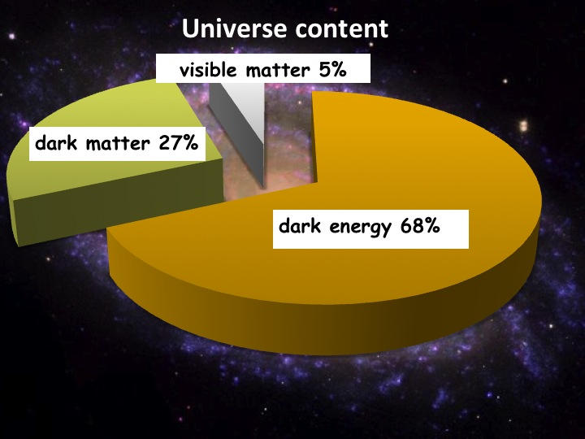
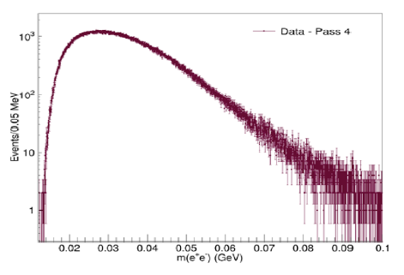
Heavy Photon Search
HPS searches for an electro-produced hidden sector photon (A’) which decays to e⁺e⁻ pairs
A’s could mediate dark matter annihilations and interactions with our matter
HPS identifies A’s with invariant mass and separated vertices
Status:
1 GeV data under analysis
  First results this summer fall?
2 GeV data acquired in spring 2016
  Results next year
More running in the future
NP-HEP Collaboration
Measured e⁺e⁻ Masses
Future Program: more HPS, APEX, DarkLIGHT

Slide 12

Contributions to the 2016 DNP Meeting
All presentations are part of a GlueX-related minisymposium spanning several sessions and including both theory and experiment talks. GlueX collaborators will present:
Σ beam asymmetry of the π⁰ and η in GlueX. (PRL in preparation)
Photoproduction of the ρ (770) with GlueX.
Photoproduction of the η’(958) with GlueX.
Photoproduction of the ω (782) with GlueX.
A survey of multi-photon final states in GlueX.
Measurement of the η’ transition form factor in GlueX.
A Leptophobic Boson search in GlueX.
Excited ρ mesons in GlueX.
Photoproduction of J/ψ in GlueX.

Slide 13
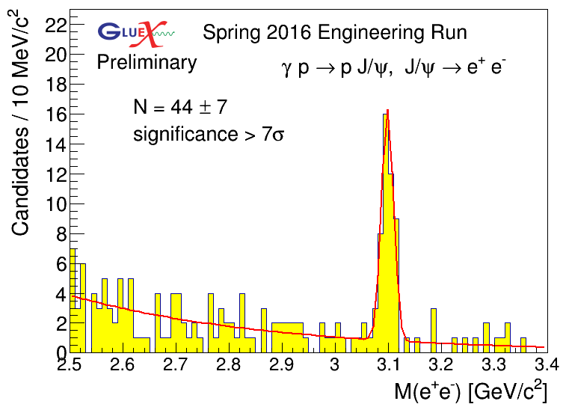
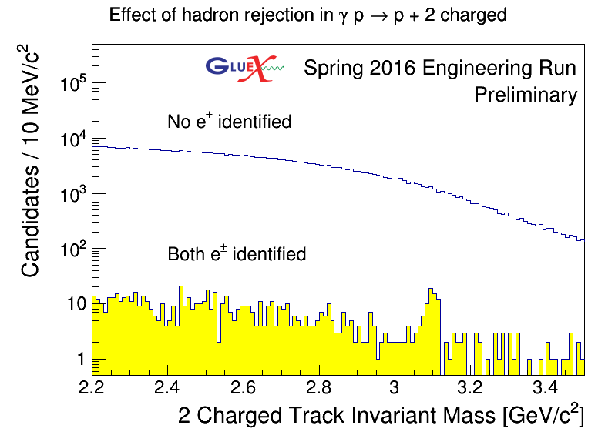
Observation of J/ψ Photoproduction in
Reconstruct exclusive final state:
Identify the p using timing and the e⁺ and e⁻ through p/E in the calorimeters.
By identifying both e+ and e-, we get over a factor of 100 in rejection power and a very clean signal.
First observation of charmonium at JLab!

Slide 14
Physics Operation with Upgraded Machine
Completed engineering run for Hall D
  Basis for about a dozen papers at DNP October 2016
Started physics operations in Hall A
  DVCS/GMp
  GMp component “complete”
  DVCS run to complete this Fall
HPS engineering run – Spring 2016, 2nd tranche, good data
  2015 results expected soon
PRAD experiment run and completed in Summer 2016
  Proton radius is currently a high profile physics issue
  Experiment was completed without negative impact on 12 GeV project installation
Congratulations from Cherry Murray on “opportunistic physics”

Slide 15
Fall 2016 Run
Planned Running
  Hall A: DVCS and G_{M}^{p}
  Hall D: GlueX
October 3: ARC7 Magnet string Box supply failure
  Hall A, G_{M}^{p}, DVCS – 4 Pass, high efficiency running
November 9, Cryomodule Window Failure
November 11, Supply Restored
November 17, resume operations
  Hall A DVCS – 5 pass
  Hall D GlueX – 5.5 pass

Slide 16
CEBAF Three-Year Schedule
Feb 2016
Calendar Year
2016
2017
2018
Fiscal Year
2016
2017
2018
Accelerator
Activity
Opportunistic
Physics
Physics
Physics
Beam
Activity
SBS Construction
Hall A
Activity
Opportunistic
Physics
Physics
Physics
Beam
CLAS12 Construction/Installation
Hall B
Activity
Activity
Non-CLAS12 Ops*
Physics
Physics
Beam
Hall C
Activity
SHMS Construction/Installation
Activity
Comm.
Physics
Physics
Beam
Opportunistic
Physics
Physics
Physics
Hall D
Activity
Beam
* PRad Summer 2016 run
Beam for Commissioning
Beam for Physics
Non-CLAS12 Ops

Slide 17
CEBAF Three-Year Schedule
Nov 2016
Modified Nov. 2016
Feb 2016
Calendar Year
2016
2017
2018
Fiscal Year
2016
2017
2018
Accelerator
Activity
Opportunistic
Physics
Physics
Physics
Beam
Activity
SBS Construction
Hall A
Activity
Opportunistic
Physics
Physics
Physics
Beam
CLAS12 Construction/Installation
Hall B
Activity
Activity
Non-CLAS12 Ops*
Physics
Physics
Beam
Hall C
Activity
SHMS Construction/Installation
Activity
Comm.
Physics
Physics
Beam
Opportunistic
Physics
Physics
Physics
Hall D
Activity
Beam
* PRad Summer 2016 run
Beam for Commissioning
Beam for Physics
Non-CLAS12 Ops

Slide 18
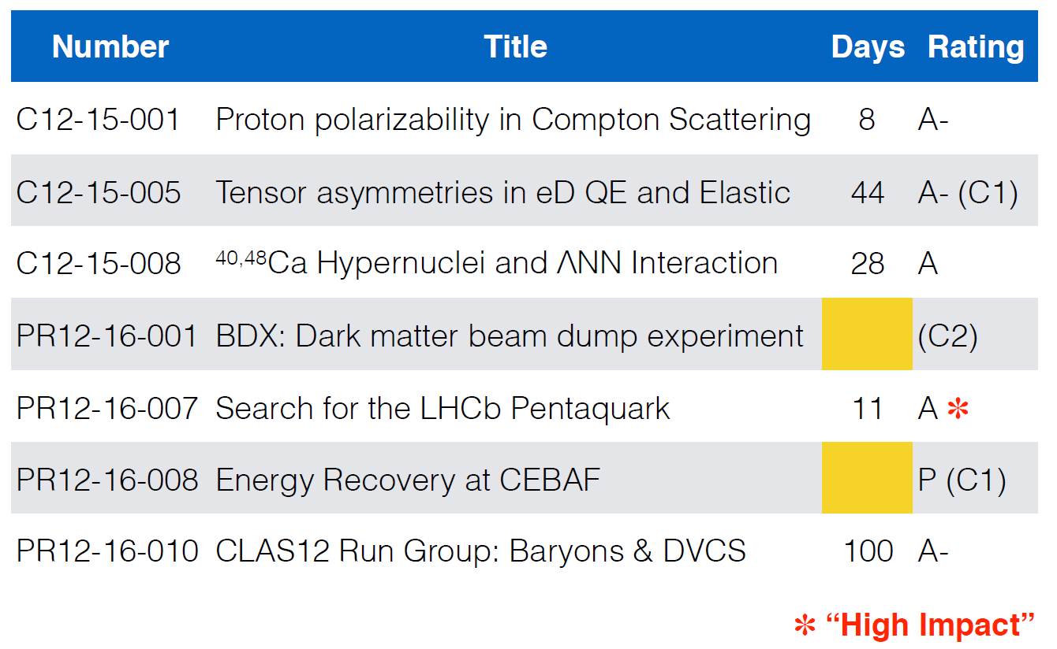
PAC44 Approvals

Slide 19
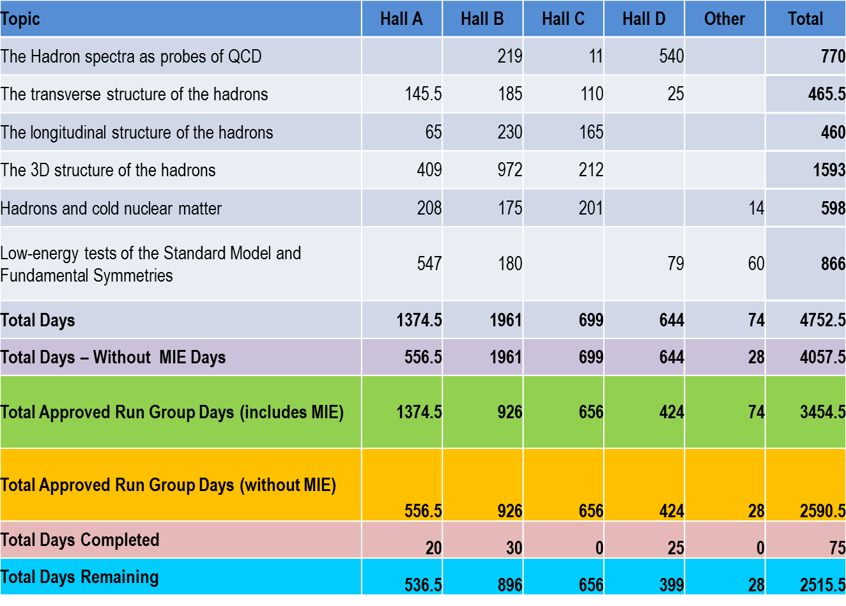
12 GeV Approved Experiments by PAC Days
A Decade of Experiments

Slide 20
Jeopardy
Process
Requested a proposal from UGBOD at January 2016 meeting. UGBOD gave some guidance, but not consensus.
Generated a proposal in April, sent to hall leaders and UGBOD. Got email feedback from UGBOD.
Added explanatory text to address feedback from UGBOD.
May 2016 – reached consensus on present draft for discussion at user meeting.
Rationale
Use normal yearly PAC for ~4 years to address all presently approved proposals that have not been scheduled, plus new proposals in the next few years. Estimate ~5-10 proposals per meeting
Will start in 2019 to reach steady state in 2024 - proposals that have been approved for 4 years or more but are not scheduled will be considered in Jeopardy.
Posted for User Comments – very minor feedback
Final Version Now Posted on PAC website

Slide 21
FY17 Budget
  Pres. Budget release Feb. 9: NP at $636M, an increase of $18M (3%)
    Major increases in isotope program ($8M) and RHIC/BNL ($7.5M)
    JLab ops up $5.5M but insufficient for full operation
  Senate mark: $636M
    Language for FRIB construction and RHIC ops
  House Mark: $620M
    Language for FRIB construction, RHIC and CEBAF ops
  Now CR at least until Dec. 9
    $5.5M below Pres. Budget (ONP is $15.4M below Pres. Budget)
    Staff payroll, execute fall run as planned
    Non-labor spending constrained at significantly less than FY16

Slide 22
JLab Outyear Budget
During FY01-FY12, CEBAF ops averaged 34.5 weeks/year (best year FY05 at 42 weeks)
For 12 GeV era we estimate “optimal” operations at 37 weeks per year
FY17 Pres. Budget includes JLab ops at $104M.
  Would fund 23 weeks (+ 3 weeks from 12 GeV project)
FY18+ at cost of living implies 23 weeks/year running (62% of optimal)
We propose FY18+ at 30 weeks/year (81%), will require ~$6M increase in operations budget.

Slide 23

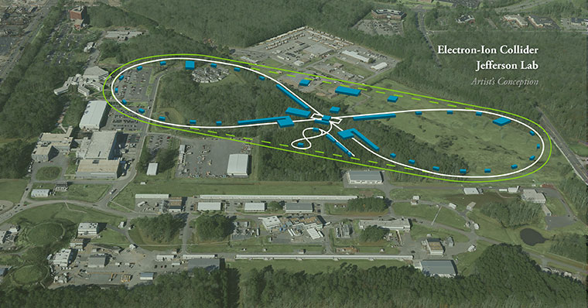
EIC at Jefferson Lab
JLab JLEIC Figure 8 Concept
Initial configuration:
  3-10 GeV on 20-100 GeV ep/eA collider
  Optimized for high ion beam polarization:
    polarized deuterons
  Luminosity:
    up to few x 10³⁴ e-nucleons cm⁻² s⁻¹
    Low technical risk
    Upgradable to higher energies
    250 GeV protons + 20 GeV electrons
    Flexible timeframe for Construction
    consistent w/running 12 GeV CEBAF
    Thorough cost estimate completed
    presented to NSAC EIC Review
    Cost effective operations
    Fulfills White Paper Requirements
Current Activities
Site evaluation (VA funds)
Accelerator, detector R&D
Design optimization
Cost reduction
Notes:
Deleted
Brightened graphic (no more shame); added current activities from previous version;
Mary Beth please format text

Slide 24
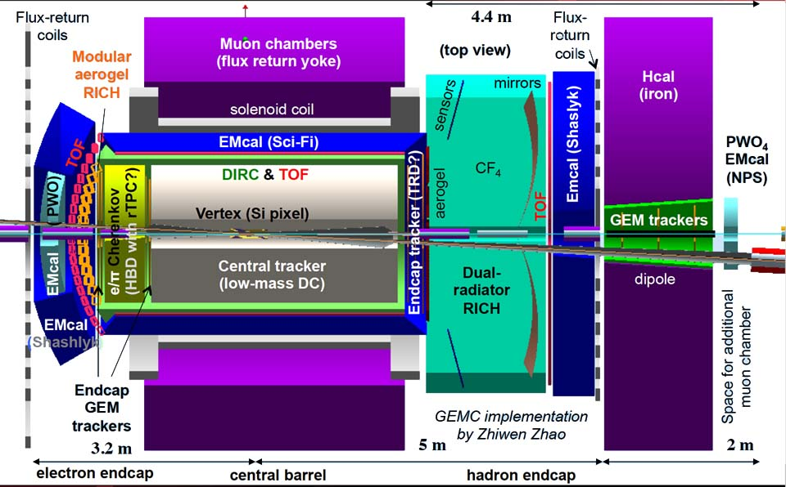
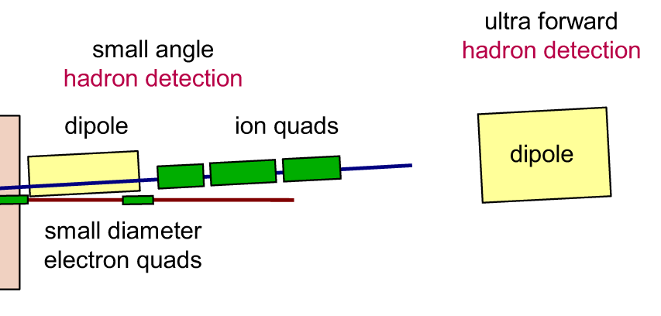
Detector Design
Detector
Backward (e Direction),
Central,
Forward, (ion direction)
and
Very Forward
ALL Important!
Zero Degree Calorimeter
hadron detection
2 Tm
ZDC
20 Tm
~70m
~35 m
~10 m
Notes:
Interior Page Design 2

Slide 25
EIC Developments
EIC User meeting at ANL July 7-10, 2016
  UG charter, elections (IB chair – Christine Aidala)
  2017 EIC UG Meeting in Trieste, Italy
DOE-NP will increase EIC accel. R&D in FY17
– Through ‘tax’ on JLab/BNL
– Peer review planned for November 29-December 2
National Academies Study, Chair Gordon Baym, University of Illinois, Urbana Champaign, first meeting projected for January 2017.
R&D Progress constrained by budgets

Slide 26


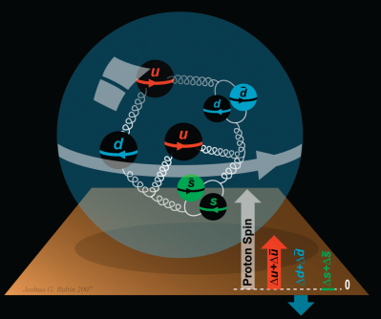
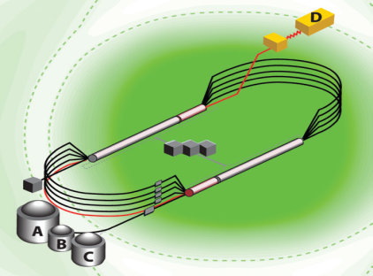
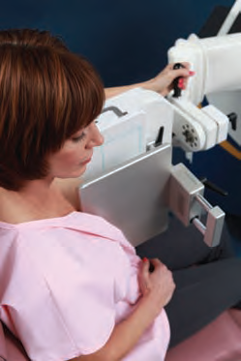
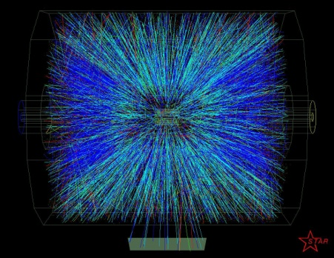


Summary and Outlook
Experiments on the floor have done well – hope for early results soon
Plan to complete upgrade, begin commissioning and full operations during the next year
PAC44 very active, new procedures being tested
Jeopardy policy in place
Operations budgets appear challenging
EIC science and designs are making good progress

Slide 27
Spares Follow

Slide 28
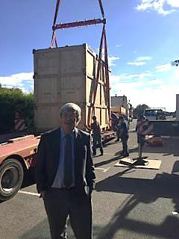
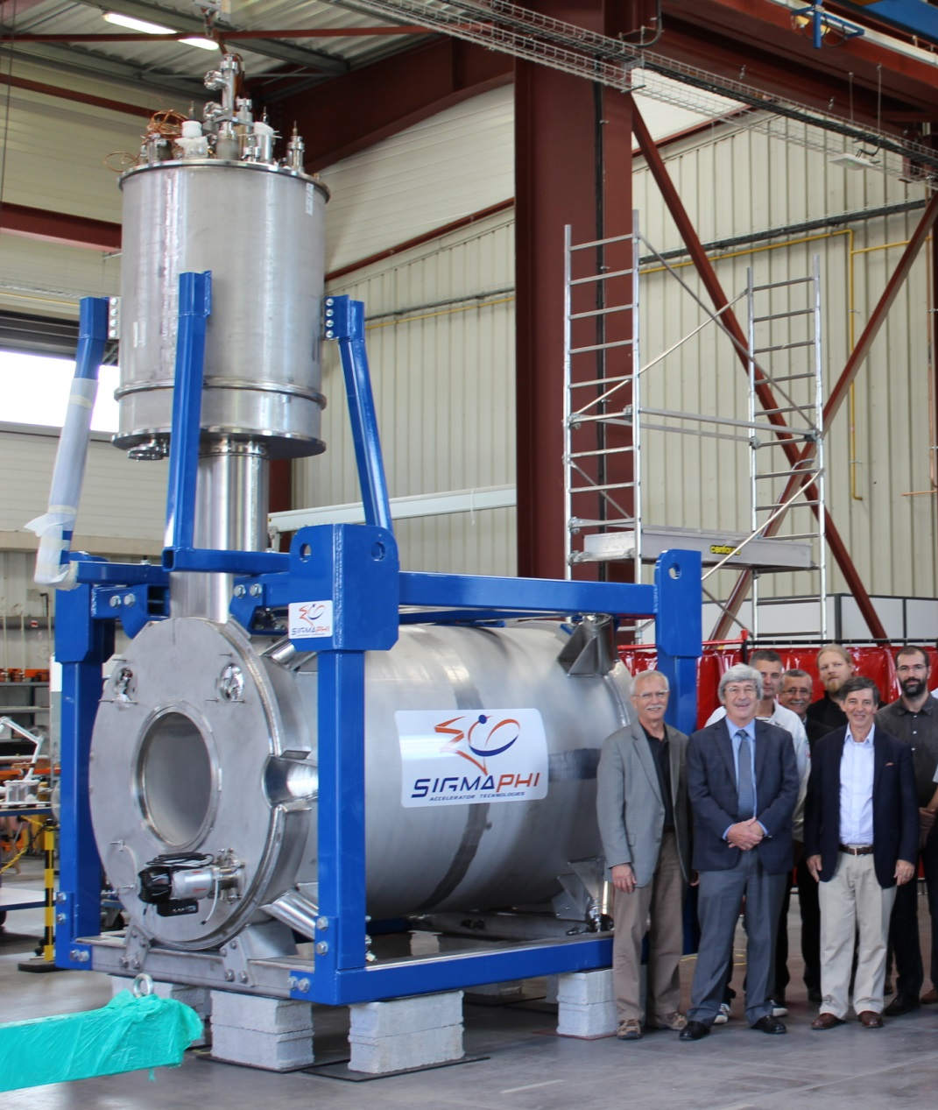
Hall C – SHMS Magnets
Crated Dipole leaving Sigma Phi
Q3 near completion in France
Dipole installed in SHMS November 2016
Q3 expected in Norfolk, November 29, 2016

Slide 29
12 GeV Project: University Detector Work
Hall | University | Activity | Status
B | Idaho State U | Drift Chamber | Complete
B | Old Dominion U | Drift Chamber | Complete
B | U South Carolina | TOF Counters | Complete
B | Moscow State U (RU) | SVT Testing | Complete
C | Michigan State U | HB Magnet | Complete
C | U Virginia | Noble Gas Cerenkov | Complete
D | U Athens (GR) | Monitoring BCAL, FCAL | Complete
D | Carnegie Mellon U | Central Drift Chamber | Complete
D | Catholic U | Tagger Hodoscope | Complete
D | U Connecticut | Tagger Microscope | Complete
D | Florida International U | Start Counter | Complete
D | Florida State U | TOF Counters | Complete
D | Indiana U | Forward Calorimeter | Complete
D | U Regina (CA) | Barrel Calorimeter | Complete
D | U Santa Maria (CH) | SiPM, Lightguides for BCAL | Complete
B, C, D | U Massachusetts | Electronics Testing | Complete
NSF-MRIs funded
Hall B PCAL Detector,
Long. Polarized Target
NSF-MRIs funded most
12 GeV Hall C Detectors
Internat’l contributions
for detectors beyond
base equipment

Slide 30
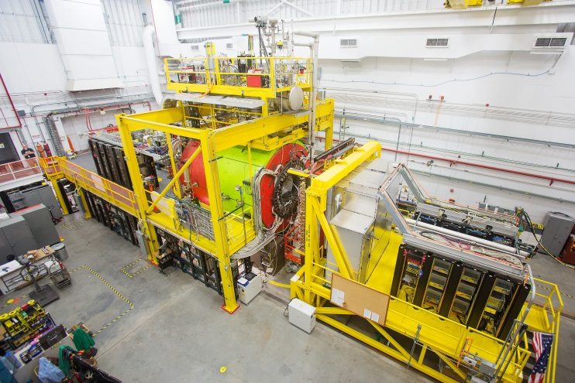
GlueX in Hall D
New experiment to study quark confinement
Commissioning complete
Detector functioning well
Production data-taking started
Poised to discover exotic hybrid mesons

Slide 31
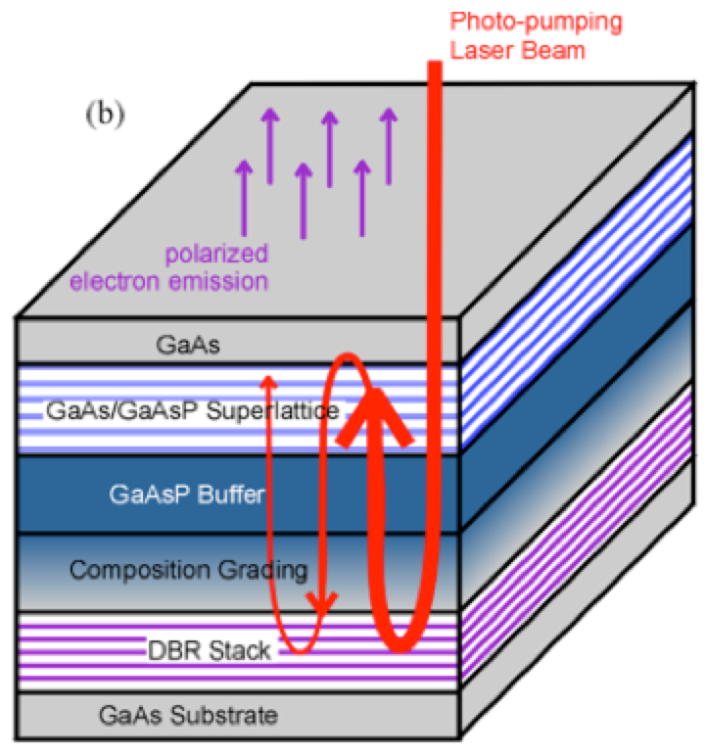
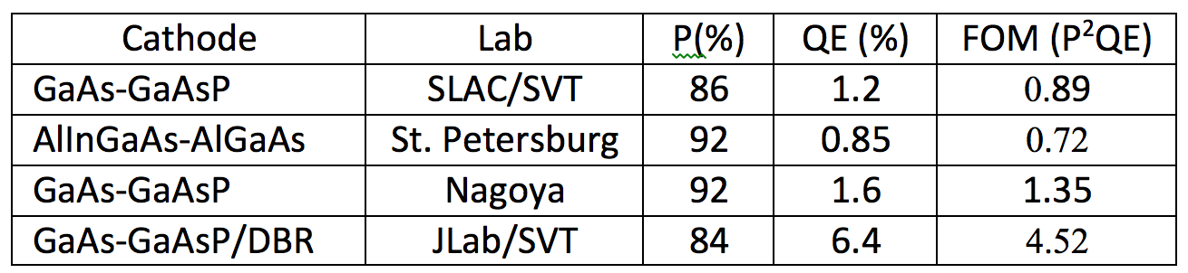
World Record High Polarization Photocathode
6.4% QE & 84% polarization at 776 nm from strained GaAs/GaAsP superlattice photocathode with GaAsP/AlAsP Distributed Bragg Reflector (DBR)
The highest QE & FOM of any reported high polarization photocathode
Possible to improve both QE & Pol
SBIR partnership
Photo-cathode
DBR
Substrate
Paper ready for SPIN and APL submission: W. Liu, S. Zhang, M. Stutzman, M. Poelker, Y. Chen, W. Lu, and A. Moy

Slide 32
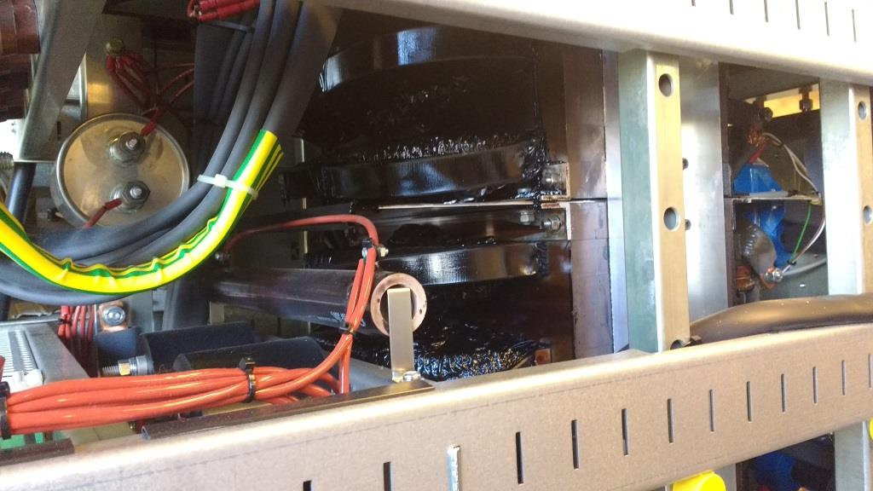
Fall 2016 Run
Hall A: DVCS and G_{M}^{p}
Hall D: GlueX
October 3: ARC7 Magnet string Box supply failure
ARC7 Box supply output filter chokes overheated, beyond repair and will need to be replaced.
Running 1-3 passes in Hall A until repair (mid-Nov)

Slide 33
PAC44
3 returning C2
9 new proposals
1 returning C2 run group
2 new run groups (Hall B)
3 run group additions
9 LOI’s
Scheduled for week of July 25
Proposals were due Monday, June 6, 2016
Charge:
Review new proposals, previously conditionally approved proposals, and letters of intent for experiments that will utilize the 12 GeV upgrade of CEBAF and provide advice on their scientific merit, technical feasibility and resource requirements.
Identify proposals with high-quality physics that, represent high quality physics within the range of scientific importance represented by the previously approved 12 GeV proposals and recommend for approval.
Also provide a recommendation on scientific rating and beam time allocation for proposals newly recommended for approval.
Identify other proposals with physics that have the potential for falling into this category pending clarification of scientific and/or technical issues and recommend for conditional approval. Provide comments on technical and scientific issues that should be addressed by the proponents prior to review at a future PAC.

Slide 34
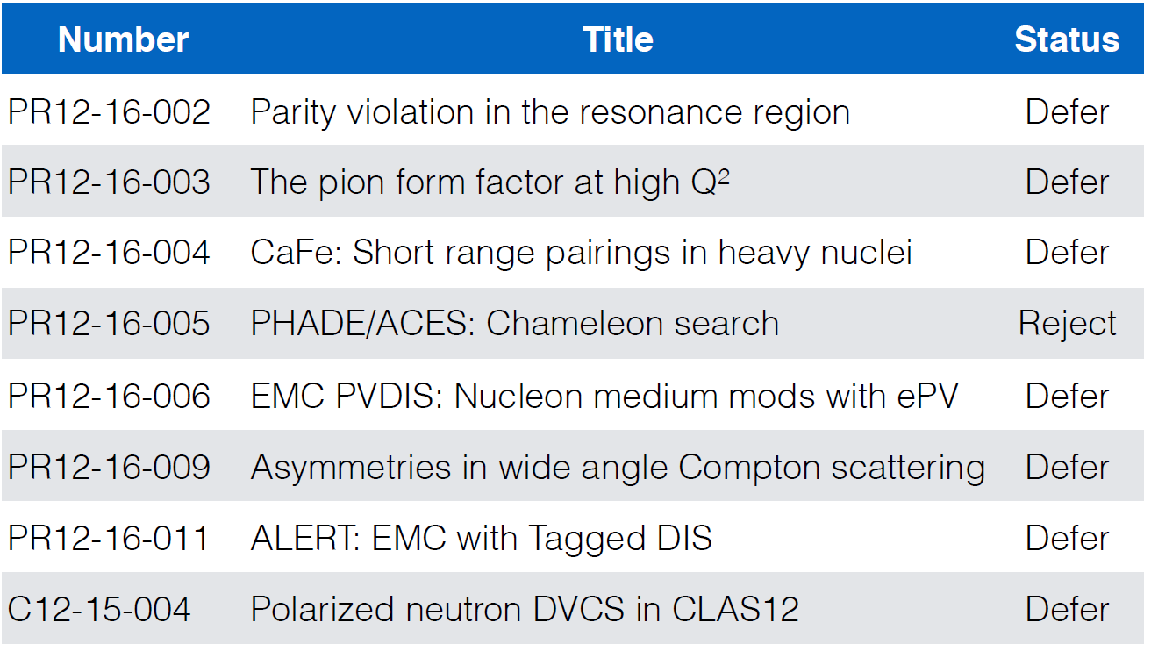
PAC44 Results

Slide 35
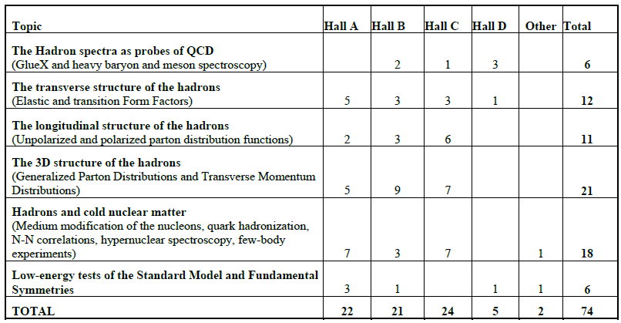
12 GeV Approved Experiments by Physics Topics

Slide 36
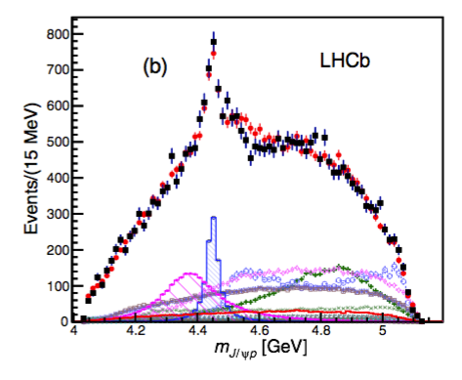
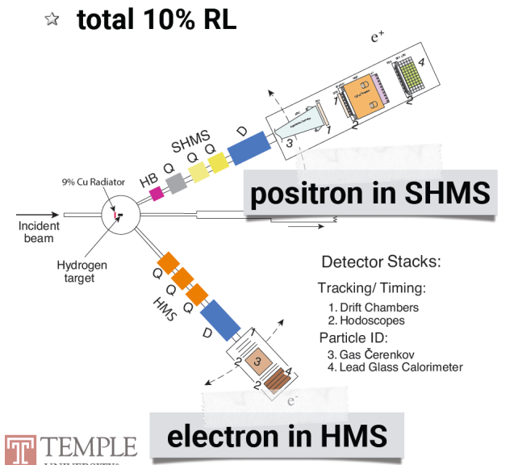
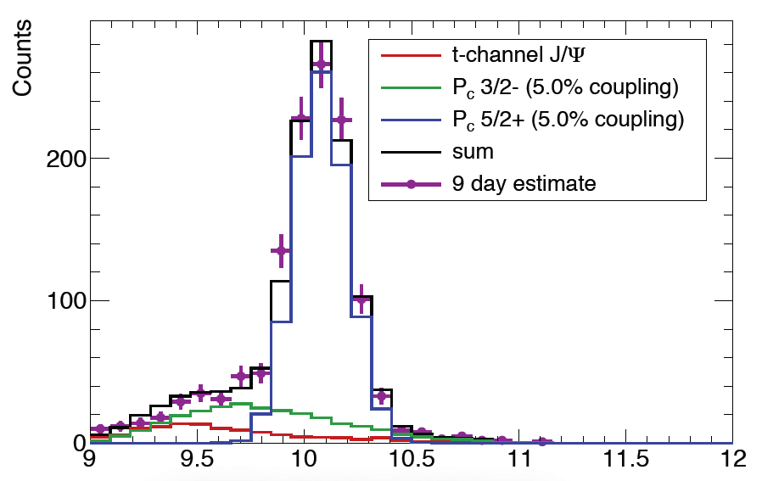

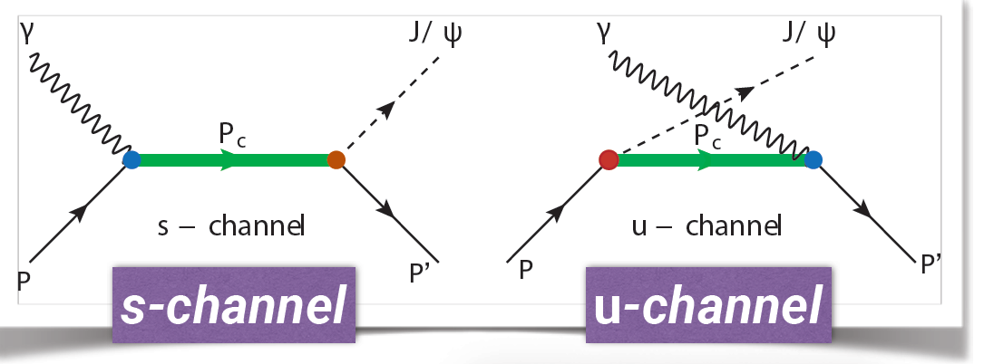
Charmonium Pentaquark
JLab E12-16-007
LHCb
2 Pc states needed to
describe results:
narrow: Pc(4450)
wide: Pc(4380)

Slide 37

2015 NSAC Long Range Plan
RECOMMENDATION I
The progress achieved under the guidance of the 2007 Long Range Plan has reinforced U.S. world leadership in nuclear science. The highest priority in this 2015 Plan is to capitalize on the investments made.
· Operate 12 GeV CEBAF
RECOMMENDATION II
We recommend the timely development and deployment of a U.S.-led ton-scale neutrinoless double beta decay experiment.
RECOMMENDATION III
We recommend a high-energy high-luminosity polarized EIC as the highest priority for new facility construction following the completion of FRIB.
· Jefferson Lab EIC (JLEIC) development
RECOMMENDATION IV
We recommend increasing investment in small-scale and mid-scale projects and initiatives that enable forefront research at universities and laboratories.
· MOLLER, SoLID

Slide 38
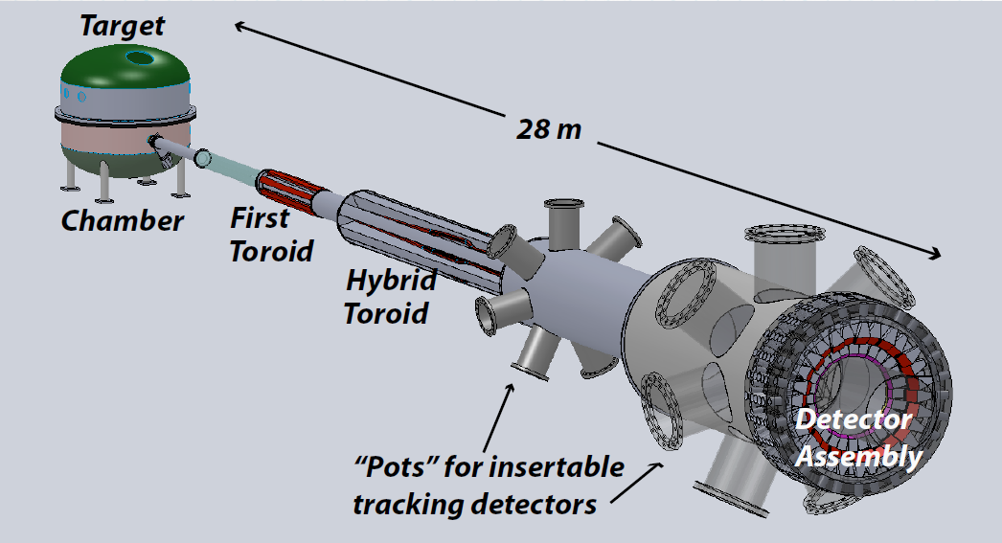

Future Projects
MOLLER experiment
(Possible MIE – FY17-20)
– Standard Model Test
– DOE science review (September 2014) – strong endorsement
– Director’s review scheduled for December 15-16, 2016 –
Technical, cost & schedule
– Now hope for FY18 start
SoLID
– CLEO Solenoid 
– Chinese collaboration
– Director’s review (Feb. 2015)
 lots of good feedback
– Collaboration briefing to DOE-NP
(Nov. 2015)

Slide 39
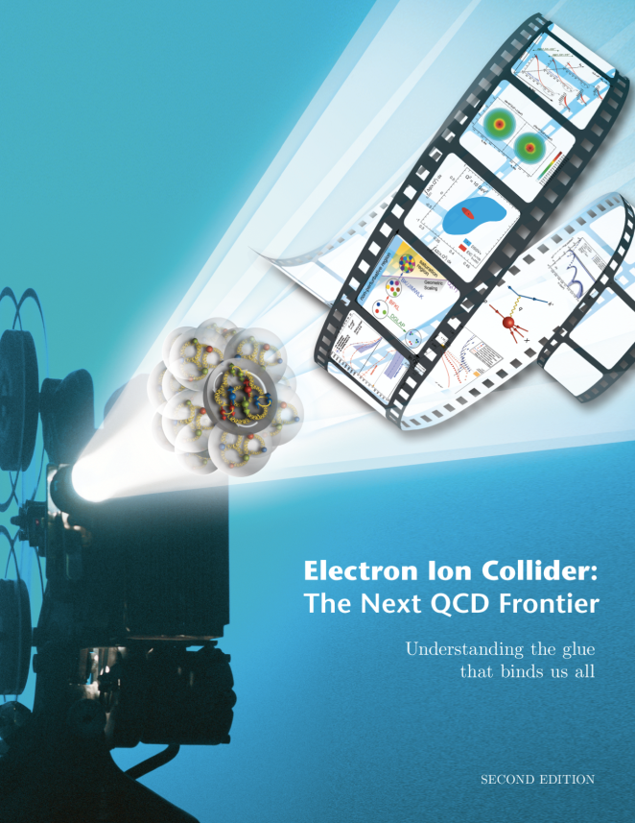
Electron Ion Collider
LRP Recommendation III
Exploring the Glue that Binds Us All
( R. Yoshida)
EIC Community
White Paper

Slide 40
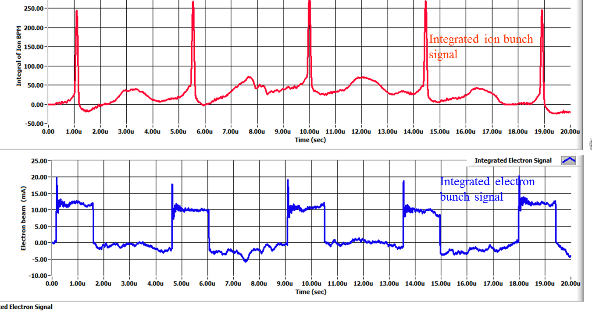
Bunched Ion Beam Cooling – preliminary results
A collaboration of JLAB and Institute of Modern Physics (IMP), China
The 1st experiment was carried out on May 17-22, 2016, at Lanzhou, China
A 7MeV/u ¹²C⁶⁺ ion beam stored in the IMP CSRm ring, either coasting or captured by 450kHz RF system (two long bunches)
Cooling of both coasting and bunched ion by a pulsed electron beam are observed: first successful step of experimental demonstration of bunched beam cooling
Data analysis both at IMP and JLAB is in progress
Initial 1D modeling with RF capture and bunching shows the ion cooling and synchrotron sideband effects, agree with experimental observations
Experiment data observation on BPMs
cooled ion bunches
uncooled ion bunches
Electron bunches 1.5μs

Slide 41
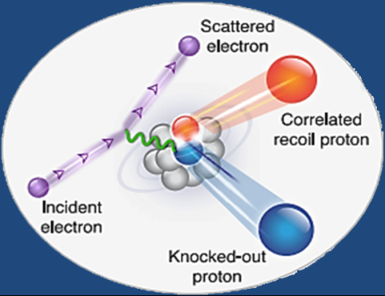
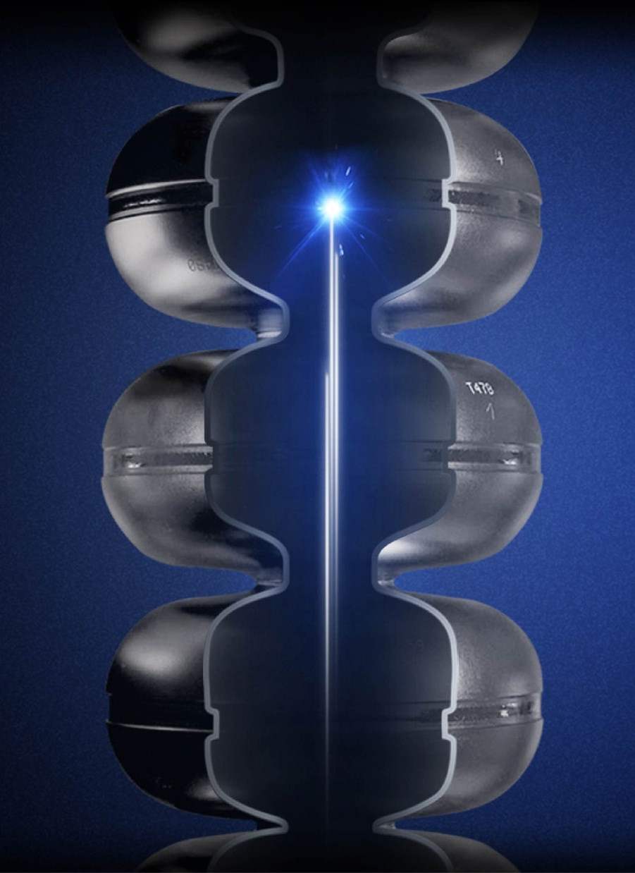
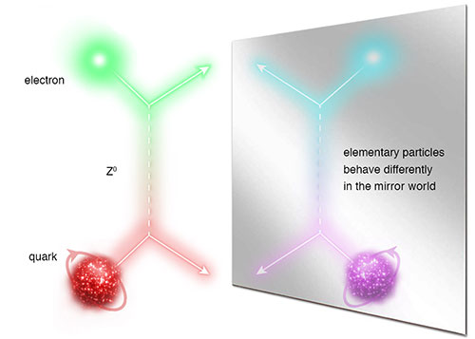
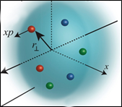
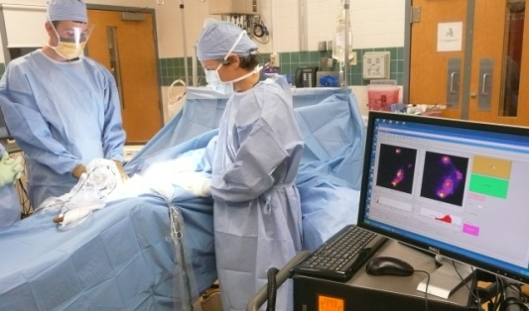



JLab: A Laboratory for Nuclear Science
Z⁰
Nuclear Structure
Fundamental
Forces & Symmetries
Structure of Hadrons
Medical Imaging
Nuclear Astrophysics
Accelerator S&T
Cryogenics
Theory & Computation

